Slide 1
About IADR
Notes:
The International Association for Dental Research (IADR) is a nonprofit organization with over 8,300 individual members worldwide, dedicated to driving dental, oral and craniofacial research to advance health and well-being through discovery and dissemination.

Slide 2
IADR Mission Statement
Drive dental, oral and craniofacial research for health and well-being worldwide.
Notes:
In 2019, the IADR created a new set of Mission, Vision and Values statements. The IADR Mission is to drive dental, oral and craniofacial research for health and well-being worldwide.

Slide 3
IADR Vision Statement
Oral health for the world through discovery and dissemination.
Notes:
The IADR Vision Statement is: Oral health for the world through discovery and dissemination.

Slide 4
IADR Values Statement
IADR Core Values
Scientific Excellence * Social Responsibility * Scientific Community
Scientific Excellence: IADR values science conducted at the highest possible levels of rigor, innovation and ethics, across disciplines, from discovery science to clinical implementation to global population health.
Social Responsibility: IADR values the pursuit of science to improve health and well-being for all people, to reduce health inequalities and inequities, and proactively takes actions and positions to improve health.
Scientific Community: IADR values a diverse and inclusive scientific workforce, promotes work-life balance, and supports educational activities and mentoring networks to develop the next generation of scientists.
Notes:
The IADR Core Values are: Excellence, Responsibility and Community.

Slide 5
IADR Board of Directors
President
Eric Reynolds
The University of Melbourne, Australia
President-elect
Brian O’Connell
Trinity College Dublin, Ireland
Vice President
Ophir Klein
University of California, San Francisco, USA
Immediate Past President
Pamela Den Besten
University of California, San Francisco, USA
Treasurer
David Drake
University of Iowa, Iowa City, USA
JDR Editor-in-Chief
Nicholas Jakubovics
Newcastle University, UK
JDR CTR Editor-in-Chief
Jocelyne Feine
McGill University, Montreal, Quebec, Canada
Regional Board Member, Africa/Middle East Region
Deema AlShammery
Riyadh Elm University, Saudi Arabia
Regional Board Member, Asia/Pacific Region
Nobuhiro Takahashi
Tohoku University, Sendai, Japan
Regional Board Member, North American Region
Aida Borges Yáñez
Universidad Nacional Autónoma de Mexico, Mexico City
Regional Board Member, Latin American Region
Maria del Carmen López Jordi
Universidad de la Republica, Montevideo, Uruguay
Regional Board Member, Pan European Region
Gottfried Schmalz
University Hospital Regensburg, Germany
Young Investigator Representative
Kimon Divaris
University of North Carolina, Chapel Hill, USA
Young Investigator Representative
Vinicius Rosa
National University of Singapore
Chief Executive Officer
Christopher H. Fox, Alexandria, VA, USA
Notes:
This is the list of the 2021-2022 IADR Board of Directors.

Slide 6
IADR Regional Structure
IADR
NAR
LAR
APR
PER
AMER
East & Southern African
Iranian
Iraqi
Kuwaiti
Nigerian
Saudi Arabian
South African
Egyptian
Jordanian
Lebanese
Libyan
Sudanese
Syrian
Tunisian United Arab Emirates
ANZ Chinese
Indian
Japanese
Korean
SEA
Mongolian
Pakistani
Argentine
Brazilian
Chilean
Colombian
Peruvian
Uruguayan
Venezuelan
Caribbean Costa Rican
Ecuadorian
Guatemalan
Panamanian
Paraguayan
AADOCR
CADR
Mexican
British
CED
Irish
Israeli
Scandinavian
Russian
28 Divisions: Black 17 Sections: Blue

Slide 7
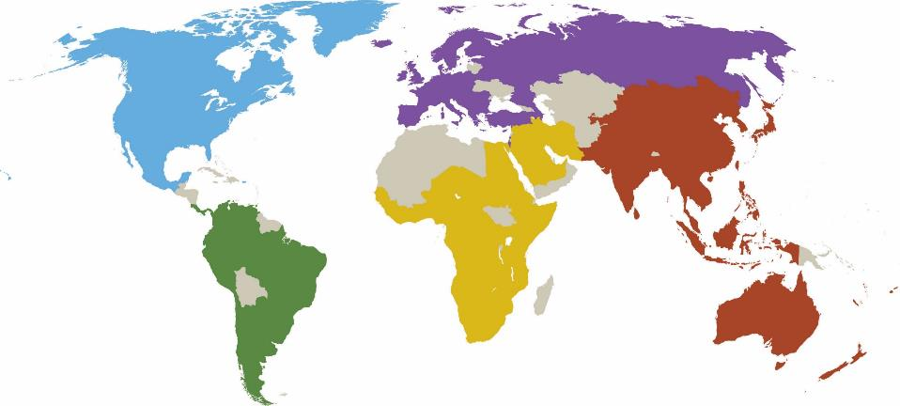
2020 IADR Membership by Region
1,930
3,308
1,477
470
806
Total Membership: 8,314
(Membership total as of December 31, 2020)
Notes:
As of December 31, 2020 IADR has over 8,300 members worldwide.

Slide 8
IADR Asia/Pacific Region Membership Breakdown
Australia/ 242
New Zealand
China 613
India 103
Japan 882
Korea 81
Pakistan 26
Southeast 258
Asian Division
Total Membership: 2,205
(Total as of August 24, 2021)
Notes:
Here is the membership breakdown by country for the IADR Asia/Pacific Region as of August 24, 2021.

Slide 9
IADR Members in Japan
Member: 703
Student Member: 113
Retired Member: 67
Affiliate Member: 1
Total Membership: 884
(As of September 7, 2021)
Notes:
Here is the breakdown of IADR members in Japan by member type as of September 7, 2021.

Slide 10
IADR Membership in Japan 2017-2021
Year | 2021 | 2020 | 2019 | 2018 | 2017
JADR Members | 884 | 939 | 1,169 | 1,234 | 1,321
Notes:
Here is the breakdown of IADR members in Japan from 2017-2021 (as of September 9, 2021).

Slide 11
IADR Adopt-a-Member Fund
100% of all donations help support IADR members!
Assist IADR members in Low and Middle-Income Countries (LMICs) by contributing to the IADR Adopt-A-Member Fund!
Donations support IADR Members and Student Members in LMICs in paying IADR annual membership dues and/or IADR General Session registration fees.
Notes:
The Adopt-a-Member program was established in 1996 to provide IADR members with the opportunity to support colleagues who did not have the means to become a member. The program supports dental, oral and craniofacial researchers in Low and Middle-Income Countries. Each year there are funds that the IADR Divisions/Sections are not able to utilize. If you are aware of members in your Division/Section that would benefit from the program please contact your Division/Section officers or contact Riana Hays, Component Relations Coordinator rhays@iadr.org.

Slide 12
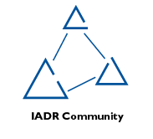
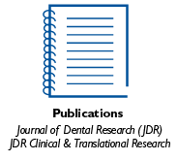
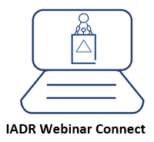
Membership Benefits
Notes:
An IADR membership offers many benefits including access to the online IADR Community, IADR Webinar connect platform, publications, discounts on meeting registrations, presentation and awards/fellowship opportunities, access to the IADR CE On Demand library and abstract archive, the Global Research Update newsletter, membership in Scientific Groups or Networks and much more.

Slide 13
Membership Benefits
Discover, network, and advance your career with an IADR membership!
Join our extensive and valuable network of over 8,300 members worldwide.
Notes:
Discover, network and advance your career with an IADR membership! Join our extensive and valuable network of over 10,000 members worldwide. Whether you are a researcher, student or other individual interested in dental, oral and craniofacial research, the IADR welcomes you as a member.

Slide 14
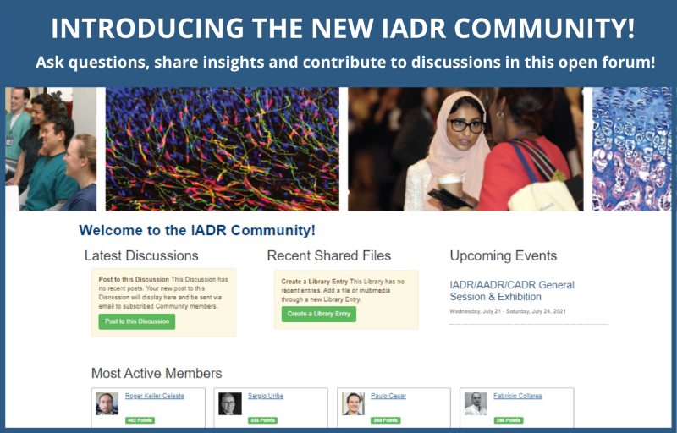
IADR Community
IADR Community
An online platform where IADR members can engage throughout the year.
Notes:
Join the IADR Community. The IADR Community is an online hub to meet and discuss research and other topics with your colleagues.

Slide 15
IADR Webinar Connect Platform
Participate in live webinars and view past webinars on demand!
Notes:
Participate in live webinars and view the growing list of past webinars. Now, members can submit a webinar proposal for consideration!

Slide 16
32 IADR Scientific Groups/Networks
Scientific Groups (24)
Behavioral, Epi & HSR
Cariology Research
Craniofacial Biology
Dental Anesthesiology and
Special Care Research
Dental Materials
Diagnostic Sciences
Education Research
Geriatric Oral Research
Implantology Research
Microbiology/Immunology
Mineralized Tissue
Neuroscience
Nutrition Research
Oral & Maxillofacial Surgery
Oral Health Research
Oral Medicine & Pathology
Orthodontics Research
Pediatric Oral Health Research
Periodontal Research
Pharmacology/Therapeutics/
Toxicology
Prosthodontics
Pulp Biology & Regeneration
Salivary Research
Stem Cell Biology
Networks (8)
Clinical and Translational Science
e-Oral Health Network
Evidence-based Dentistry
Global Oral Health Inequalities Research
International Network for Orofacial Pain and Related Disorders Methodology (INfORM)
Network for Practice-based Research
Student Training and Research (STAR)
Women in Science Network
Notes:
This is a list of the IADR Scientific Groups and Networks. IADR members may enjoy complimentary membership in one IADR Scientific Group or Network and Student members can join up to three IADR Scientific Groups or Networks as part of their Student membership. Please be active in at least one.

Slide 17
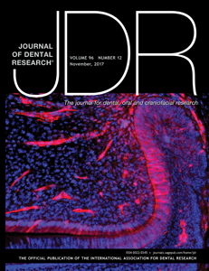
Journal of Dental Research
Full 2021 Journal Citation Reports™ results for the JDR:
2-year Journal Impact Factor™: 6.116, ranking #5 of 91 journals
5-year Journal Impact Factor™: 7.199, ranking #3 of 91 journals
Eigenfactor: 0.01683, ranking #1 of 91 journals
Total citations: 26,197, ranking #1 of 91 journals
Journal Citation Indicator: 2.39, ranking #2 of 91 journals
Article Influence Score: 1.726, ranking #3 of 91 journals
Average time from submission to first decision: 16.5 days
Average time from acceptance to online publication: 31 days
Published manuscripts appear in print and OnlineFirst, by which forthcoming articles are published online before they are scheduled to appear in print.
COVID-19 research manuscripts are eligible for fast-track review.
www.iadr.org/jdr
Follow the JDR on Twitter @JDentRes!
Notes:
The Journal of Dental Research (JDR) 2-year Journal Impact Factor™ is over 6 for the first time at 6.116, ranking #5 of 91 journals in the “Dentistry, Oral Surgery & Medicine” category, and the JDR 5-year Journal Impact Factor™ is over 7 for the first time at 7.199 score, ranking #3 of 91 journals. The JDR also ranks #1 of 91 journals in total citations and Eigenfactor, #2 in the new Journal Citation Index and #3 in Article Influence Score. This news comes from the 2021 Journal Citation Reports™ (Clarivate™, 2020).

Slide 18
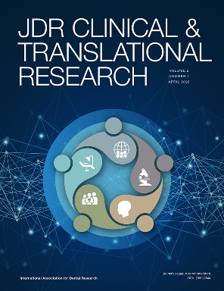
JDR Clinical & Translational Research
The JDR CTR has been accepted for inclusion in MEDLINE!
JDR Clinical & Translational Research focuses on publishing original dental, oral and craniofacial research at the interface between discovery science, and clinical application with the translation of research into healthcare delivery systems at the individual patient, clinical practice and community levels.
Average time from submission to first decision: 29.5 days
Average time from acceptance to online publication: 28 days
COVID-19 research manuscripts are eligible for fast-track review.
www.iadr.org/jdrctr
Follow the JDR CTR on Twitter @JDRClinTransRes!
Notes:
The JDR CTR has been accepted for inclusion in MEDLINE!
MEDLINE, created by the U.S. National Library of Medicine (NLM), is the authoritative bibliographic database containing citations and abstracts in the fields of medicine, nursing, dentistry, veterinary medicine, health care systems and preclinical sciences from around the world and is used internationally by clinicians, researchers and policy makers to access the world's biomedical research literature. A distinctive feature of MEDLINE is that the records are indexed with the NLM Medical Subject Headings (MeSH®). MEDLINE is the primary component of PubMed® — a database with over 29 million citations for life sciences and biomedical literature.

Slide 19
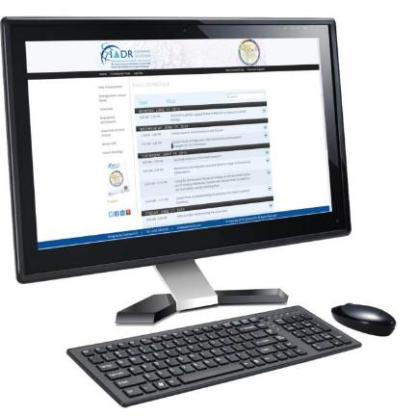
IADR CE On Demand
As part of your IADR membership benefits, through the IADR CE On Demand library you have access to the recordings from IADR meetings. Recordings are available from the 2016, 2017, 2018, 2019, and 2020 meetings.
Notes:
Select recordings from IADR and AADOCR meetings are available in the IADR CE On Demand library. Please access the recordings if you haven’t already done so to learn more of the science that was presented at previous meetings.

Slide 20
IADR Awards and Fellowships
There are more than 40 awards and fellowships in various categories, including student awards.
IADR Distinguished Scientist Awards
17 different categories
Scientific Group Awards
IADR Hatton Competition
Junior, Senior Clinical, and Senior Basic Science
Notes:
IADR has opportunities for members to be recognized for their research contributions through Awards and Fellowships. There are more than 40 awards and fellowships in various categories, including student awards. Visit the IADR website for the deadlines for the 2021 Awards and Fellowships.

Slide 21
IADR International Advocacy Toolkit
IADR’s International Advocacy Toolkit was created to assist IADR members throughout the world in developing advocacy campaigns in support of dental, oral and craniofacial research.
The Toolkit covers the foundation for advocacy—what it is and why it matters—as well as what information to consider when developing an advocacy strategy.
Through use of this Toolkit, IADR members can feel empowered to champion this research and promote funding and policies that contribute to scientific advancement.
View the toolkit online at www.iadr.org/IADR/About-Us/Advocacy-Toolkit.
Notes:
The International Association for Dental Research has developed an International Advocacy Toolkit to assist its members throughout the world in developing advocacy and communications campaigns in support of dental, oral and craniofacial research. The Toolkit covers the foundation for advocacy — what it is and why it matters — as well as what information to consider when developing an advocacy strategy. Through use of this Toolkit, IADR members can feel empowered to champion this research and work to promote funding and policies that contribute to scientific advancement.
View the toolkit online at www.iadr.org/IADR/About-Us/Advocacy-Toolkit. (Please note: This toolkit was developed as a resource for IADR members. Users must log into the IADR Member Portal to access the toolkit.)

Slide 22
IADR COVID-19 Resources Webpage
COVID-19 Articles Published
in JDR and JDR CTR
Call for COVID-19 Papers
AADOCR Webinar Series
Research Funding
Association News
www.iadr.org/COVID-19
Notes:
During these challenging times, IADR has provided several COVID-19 resources, including a call for COVID-19-related papers for the JDR or JDR CTR, to keep our members updated on the latest dental, oral and craniofacial research news related to this topic.

Slide 23
Notes:
Save the date for the hybrid 100th General Session & Exhibition of the IADR and the 5th Meeting of the IADR Asia Pacific Region to be held online and onsite in Chengdu, China—submit your research today!

Slide 24
Membership, Meetings & Journals
Questions about IADR membership, journals or meetings may be directed to research@iadr.org or +1.703.548.0066. Visit IADR online at www.iadr.org.
Notes:
In closing, more information about the items I have covered is available on the IADR website. If you have questions, please feel free to contact the IADR Global Headquarters by phone or email.

Slide 25
Notes:
Follow IADR on social media!

